Slide 1

DEPARTMENT OF INFORMATION TECHNOLOGY
DECENTRALIZED VOTING SYSTEM USING BLOCKCHAIN
Presented by:
1.Santhosh T (113320205034)
2.Deepak V (113320205008)
3.Nithesh S (113320205040)
GUIDE NAME:
MR M.DHINAKARAN Ph.D
Assistant Professor
Department of IT

Slide 2
ABSTRACT
Online voting is a trend that is gaining momentum in modern society. It has great potential to decrease organisational costs and increase voter turnout. It eliminates the need to print ballot papers or open polling stations—voters can vote from wherever there is an Internet connection. Despite these benefits, online voting solutions are viewed with a great deal of caution because they introduce new threats. A single vulnerability can lead to large-scale manipulations of votes. Electronic voting systems must be legitimate, accurate, safe, and convenient when used for elections. Nonetheless, adoption may be limited by potential problems associated with electronic voting systems. Blockchain technology came into the ground to overcome these issues and offers decentralized nodes for electronic voting and is used to produce electronic voting systems mainly because of their end-to-end verification advantages. This technology is a beautiful replacement for traditional electronic voting solutions with distributed, non-repudiation, and security protection characteristics. The following article gives an overview of electronic voting systems based on blockchain technology. The main goal of this analysis was to examine the current status of blockchain -based voting research and online voting systems and any related difficulties to predict future developments. This study provides a conceptual description of the intended blockchain -based electronic voting application and an introduction to the fundamental structure and characteristics of the blockchain in connection to electronic voting. As a consequence of this study, it was discovered that blockchain systems may help solve some of the issues that now plague election systems. On the other hand, the most often mentioned issues in blockchain applications are privacy protection and transaction speed. For a sustainable blockchain -based electronic voting system, the security of remote participation must be viable, and for scalability, transaction speed must be addressed

Slide 3
Blockchain Voting System
Blockchain technology provides a platform for creating a highly secure, decentralized, anonymized, yet auditable chain of record, used presently in cryptocurrency systems.
This same technology could also be used to record and report votes and prevent many types of voter fraud in elections.
Blockchain Voting System will be made by connecting from
1. Remix IDE
2. Metamask
3. Ganache

Slide 4
MOTIVE OF THE PROJECT
With the help of this vast technology we can store the votes as a transaction in a block chain which cannot be modified.
The master key to build an electronic voting system is to find out a secure underlying platform which provides the required features that overcomes the drawbacks of the current system.

Slide 5
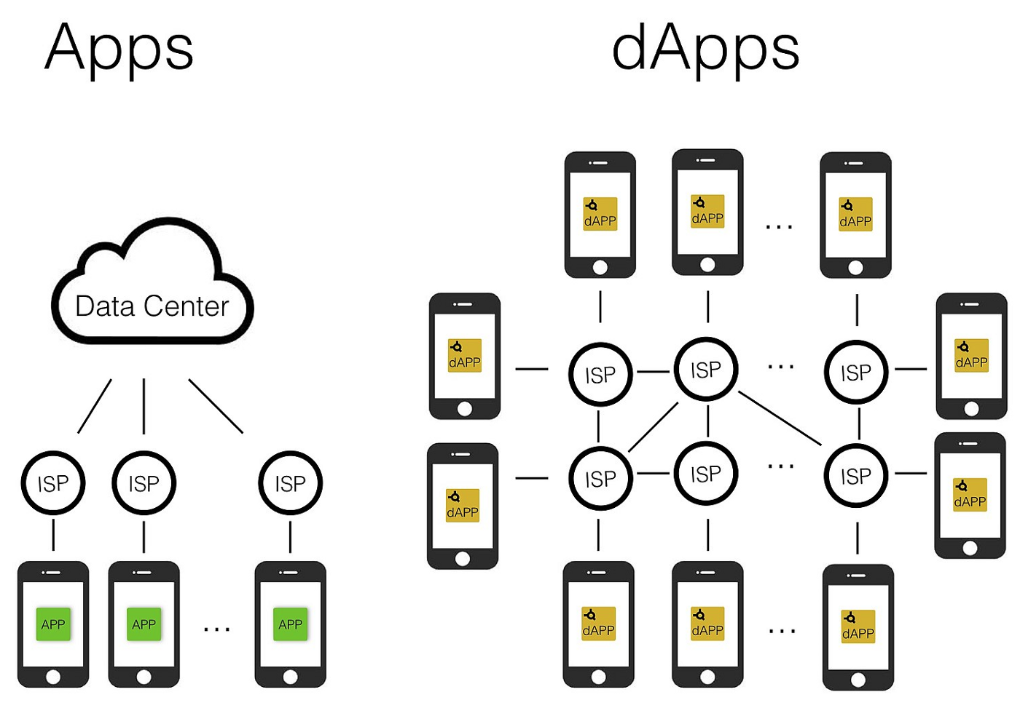
How dApp works:

Slide 6
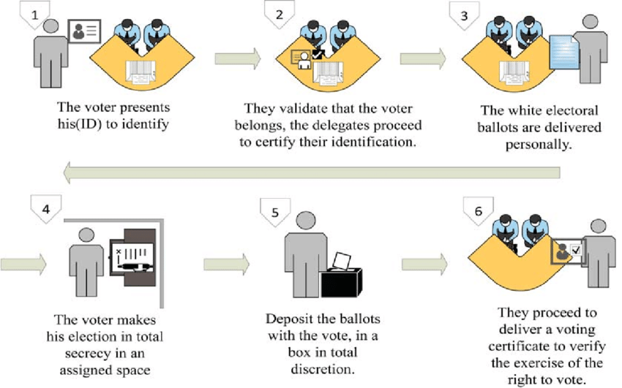
Traditional voting system:

Slide 7
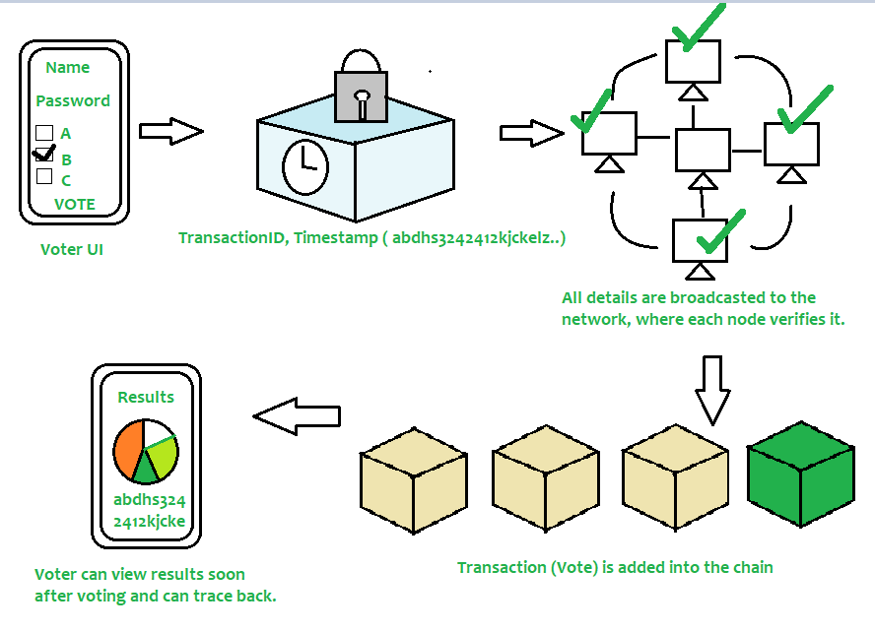
DECENTRALIZED VOTING SYSTEM:

Slide 8
SOFTWARE REQUIREMENTS
OPERATING SYSTEM : Windows 10
Tool : Remix ide, Ganache, Metamask
Hardware Requirements:
Processor : core i5
Ram : 4GB

Slide 9
ADVANTAGES
Voters save time and cost by being able to vote independently from their location.
This may increase overall voter turnout.
There is no central authority its completely decentralized.

Slide 10
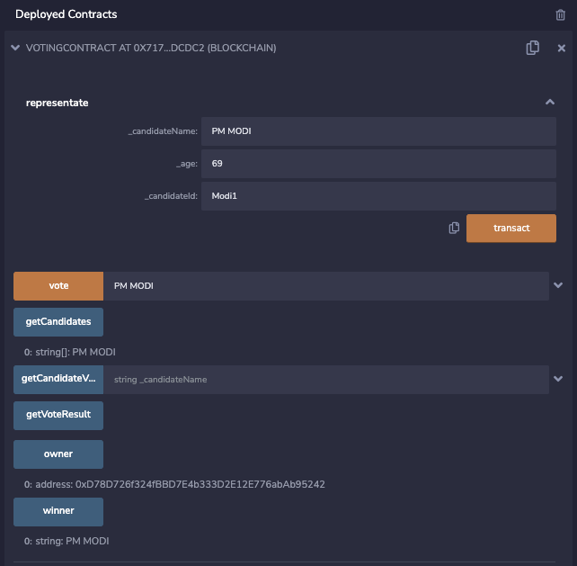
Proposed System:

Slide 11
THANK YOU

